Slide 1
Validating an XML Document
Notes:
Based on Tutorial 3 of XML Perspectives text

Slide 2
Creating a Valid Document
You validate documents to make certain necessary elements are never omitted.
Some elements and attributes may be optional, for example an e-mail address.
For example, each customer order must include a customer name, email address, and phone number. However, the address may be optional
Notes:
As of 2009, DTDs largely superceeded by XML schema but still in widespread, historical use
For examples and getting class involvement:
http://www.w3schools.com/xml/xml_dtd_examples.asp
http://www.xmlfiles.com/dtd/dtd_examples.asp
Verbally decode and manually validate different lines of the DTD

Slide 3
Why Declare a DTD
Ensure all required elements are present in the document
Prevent undefined elements from being used
Enforce a specific data structure
Specify the use of attributes and define their possible values
Define default values for attributes
Describe how the parser should access non-XML or non-textual content

Slide 4
Declaring a DTD
A document type definition is a collection of rules or declarations that define the content and structure of the document.
A document type declaration attaches those rules to the document’s content.<!DOCTYPE>
There can only be one DTD per XML document

Slide 5
Declaring an Internal Subset
The DOCTYPE declaration for an internal subset is:
<!DOCTYPE root
[
declarations
]>
root is the name of the document’s root element
declarations are the statements that comprise the DTD

Slide 6
Declaring an External Subset
The DOCTYPE declaration for external subsets can take two forms: one that uses a SYSTEM location and one that uses a PUBLIC location.
The syntax is:
<!DOCTYPE root SYSTEM “uri”> or
<!DOCTYPE root PUBLIC “id” “uri”>
root is the document’s root element
id is a text string that tells an application how to locate the external subset
uri is the location and filename of the external subset.

Slide 7
Combining Internal & External
A DOCTYPE declaration can indicate both an external and an internal subset. The syntax is:
<!DOCTYPE root SYSTEM “URI”
[
declarations
]>
If both the internal subset takes precedence over the external subset if there is a conflict
External subset defines basic rules for all the documents
Internal subset defines rules specific to each file
Notes:
Internal DTD is easier to compare the DTD to the document’s content
External DTD that can be shared among many documents written by different authors
External DTDs are much more powerful
Every element used in the document must be declared in the DTD for the document to be valid.

Slide 8
Declaring Document Elements
The element declaration syntax is:
<!ELEMENT element content-model>
element is the element name
content-model specifies what type of content the element contains.

Slide 9
Declaring Elements
The element name is case sensitive.
DTDs define five different types of element content:
Any elements. No restrictions on the element’s content
Empty elements. The element cannot store any content
#PCDATA. The element can only contain parsed character data
Elements. The element can only contain child elements
Mixed. The element contains both a text string and child elements
Notes:
Orders_1 – raw XML going to defined DTD for it.

Slide 10
Types of Element Content
ANY content: The declared element can store any type of content. The syntax is:
<!ELEMENT element ANY>
<!ELEMENT company_name ANY>
EMPTY content: This is reserved for elements that store no content. The syntax is:
<!ELEMENT element EMPTY>
<!ELEMENT hr EMPTY>

Slide 11
Types of Element Content
Parsed Character Data content: These elements can only contain parsed character data. The syntax is:
<!ELEMENT element (#PCDATA)>
<!ELEMENT Customer_ID (#PCDATA)>

Slide 12
Types of Element Content
Element content: The syntax for declaring that elements contain only child elements is:
<!ELEMENT element (children)>
<!ELEMENT notes (to, from, note)>
Each child element needs to be defined individually
The order of the child elements must match the order defined in the element declaration. In the example, ‘to’ comes before ‘from’ comes before ‘note’

Slide 13
Allowing Choice
Can list child elements as a set of possible child elements. The syntax is:
<!ELEMENT element (child1|child2|…)>
<!ELEMENT customer (name | company)>
The example allows the customer element to contain either the name element or the company element, but not both of them

Slide 14
Modifying Symbols
Symbols appended to the content model to indicate the number of occurrences of each element
a question mark (?), allow zero or one of the item
a plus sign (+), allow one or more of the item
an asterisk (*), allow zero or more of the item
<!ELEMENT customers (customer+)>
Allows the customers element to contain one or more customer elements

Slide 15
Declaring Element Attributes
For a document to be valid, all the attributes associated with elements must also be declared
To enforce attribute properties, you must add an attribute-list declaration to the document’s DTD

Slide 16
Declaring Element Attributes
The attribute-list declaration :
Lists the names of all attributes associated with a specific element
Specifies the data type of the attribute
Indicates whether the attribute is required or optional
Provides a default value for the attribute, if necessary
Can be placed anywhere within the DTD, although it is easier if they are located adjacent to the declaration for the element with which they are associated

Slide 17
Declaring Element Attributes
The syntax to declare a list of attributes is:
<!ATTLIST element attribute1 type1 default1
attribute2 type2 default2
attribute3 type3 default3…>
element is the name of the element associated with the attributes
attribute is the name of an attribute
type is the attribute’s data type
default indicates whether the attribute is required or implied, and whether it has a fixed or default value.

Slide 18
Attribute Types
While all attribute types are text strings, you can control the type of text used with the attribute. There are three general categories of attribute values:
CDATA types are simplest form and can contain any character except those reserved by XML
Enumerated types are attributes that are limited to a set of possible values
Tokenized types are text strings that follow certain rules for the format and content
Notes:
Orders_3

Slide 19
Enumerated Types
The general syntax for of an enumerated type is:
attribute (value1 | value2 | value3 | …)
For example, the following declaration:
customer custType (home | business )
restricts custType to either “home” or “business”

Slide 20
Enumerated Types
notation type: associates the value of the attribute with a <!NOTATION> declaration located elsewhere in the DTD.
The notation provides information to the XML parser about how to handle non-XML data

Slide 21
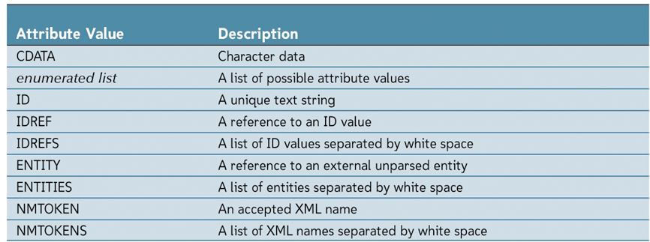
Tokenized Types
For example, if a customer ID needs to be unique, you may use the ID token:
customer custID ID

Slide 22
Attribute Defaults
Final part of an attribute declaration
Possible defaults:
#REQUIRED: the attribute must appear with every occurrence of the element.
#IMPLIED: The attribute is optional.
An optional default value: A validated XML parser will supply the default value if one is not specified.
#FIXED: The attribute is optional but if one is specified, it must match the default.

Slide 23
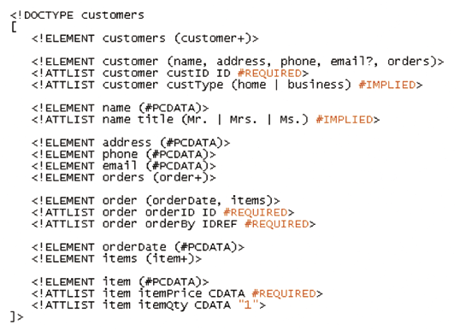
Example DTD with Declarations
Notes:
http://www.w3schools.com/xml/xml_dtd_examples.asp
Verbally decode and manually validate different lines of the DTD

Slide 24
Working With Entities
Entities are storage units for a document’s content
The most fundamental entity is the XML document itself and is known as the document entity. Entities can also refer to:
a text string
a DTD
an element or attribute declaration
an external file containing character or binary data

Slide 25
General Parsed Entities
General entities are declared in the DTD of a document. The syntax is:
<!ENTITY entity “value”>
entity is the name assigned to the entity and value is the general entity’s value.
For example, an entity named “DCT5Z” can be created to store a product description:
<!ENTITY DCT5Z “Topan Digital Camera 5 Mpx”>

Slide 26
General Parsed Entities
After an entity is declared, it can be referenced anywhere within the document.
<item>&DCT5Z;</item>
This is interpreted as
<item>Tapan Digital Camera 5 Mpx</item>
Notes:
Think of it as an “alias” or nick-name
Note the ‘&’ syntax referencing an entity

Slide 27
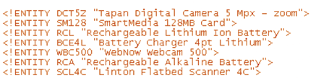
Examples of Entities in a DTD

Slide 28
Unparsed Entities
Needed to reference binary data such as images or video clips
Unparsed entity includes instructions for how the unparsed entity should be treated
A notation is declared that identifies a resource to handle the unparsed data.

Slide 29
Unparsed Entities
For example, to create a notation named “jpeg” that points to an application paint.exe:
<!NOTATION jpeg SYSTEM “paint.exe”>
Once the notation has been declared, you then declare an unparsed entity that instructs the XML parser to associate the data to the notation

Slide 30
Unparsed Entities
For example, to take unparsed data in an dct5z.jpg file and assign it to an unparsed entity named “jpeg :”, use the following:
<!ENTITY DCT5 SYSTEM “dct5z.jpg” NDATA jpeg>
Notation is the jpeg notation points to the paint.exe file
This declaration does not tell the paint.exe application to run the file
It simply identifies for the XML parser what resource is able to handle the unparsed data

